Slide 1
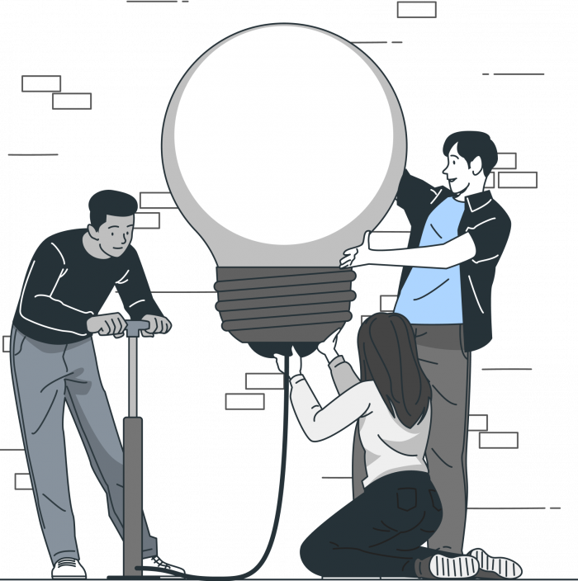
DATA ANALYTICS
FOR BETTER BUSINESS DECISONS
Problem Statement:
Understanding Career Aspiration of Gen-Z
Presented by Shaktiprasad Rajbhar

Slide 2

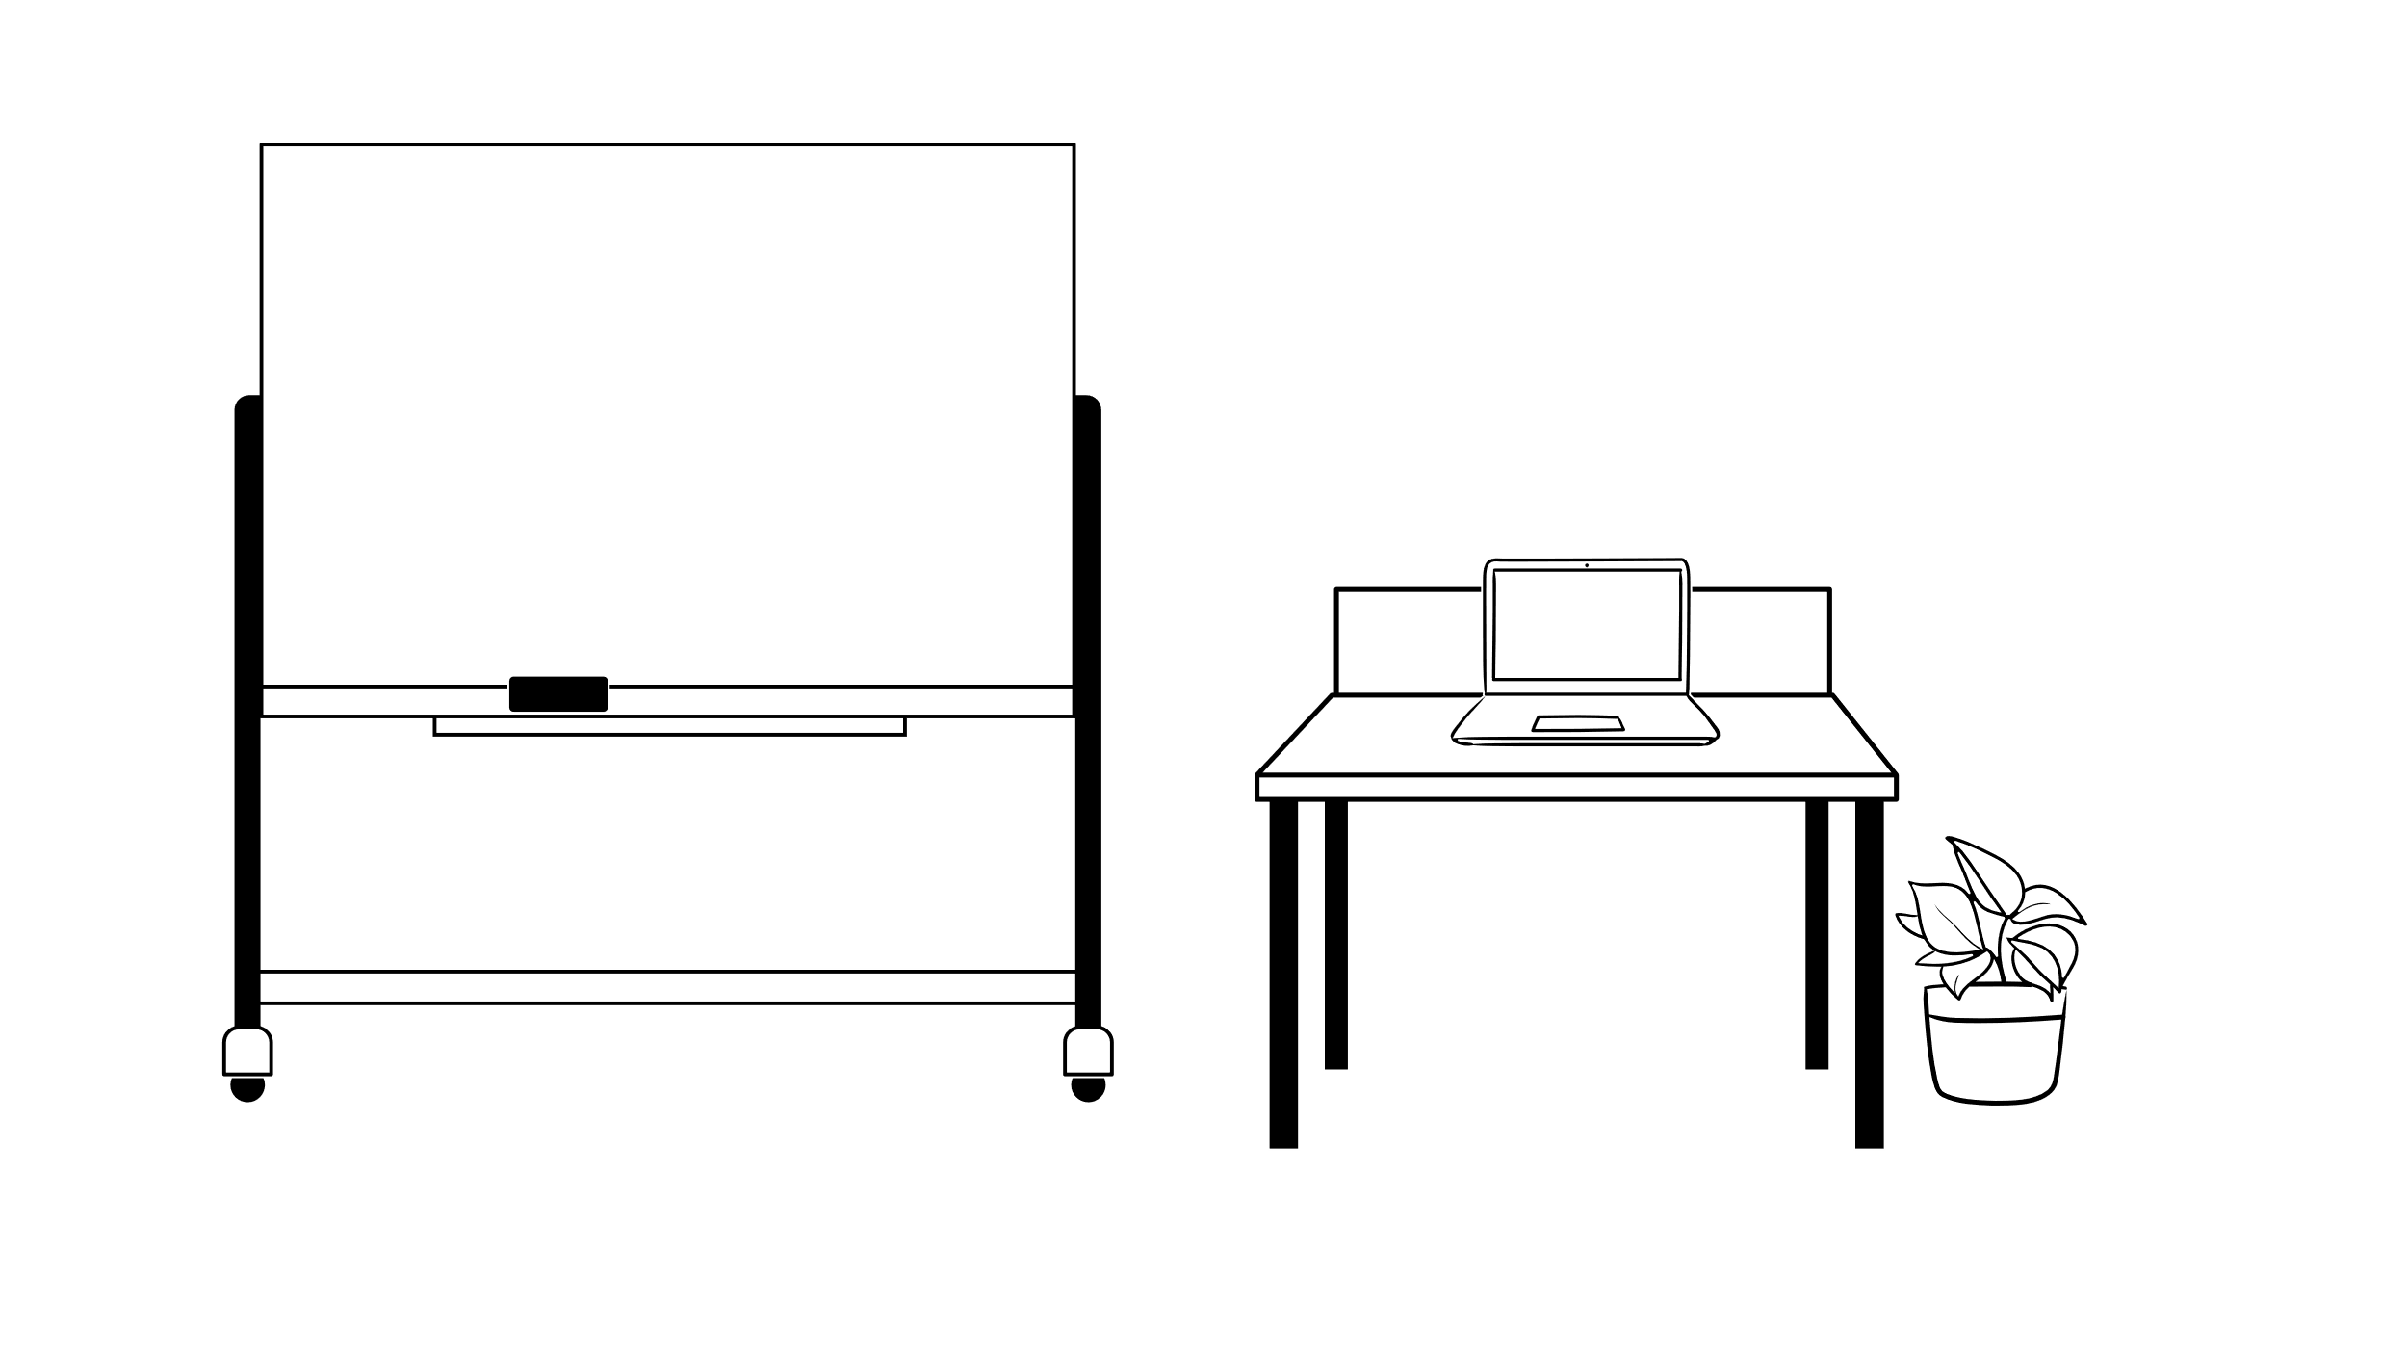


Successful Learning Road Map
Step 5
Data-driven Evaluation.
Power Point slides for final insights
Presentation for better business decision.
Step 4
Introduction to power bi
Creating a comprehensive Dashboard and focus area Dashboards.
Step 3
Collecting Data from different sources.
Cleaning Data using SQL.
Analysis of Business questions using SQL.
Step 2
Approaching the problem statement solution.
Personal aspirations and challenges for better understanding of the problem statement
Creating a Business Research Document.
Step 1
Creating Dashboards with MS-Excel like pro
Introduction to the problem statement.
Research for better problem-understanding

Slide 3

Research about problem statement to get a better understanding.
Problem Statement:
Understanding Career Aspiration of Gen-Z
For this problem statement, we are going to discuss and understand about the Career Aspirations of Generation-Z who are going to be the 25-27% of the total workforce of our country by 2030, their contributions will be huge in the prospect of our countries and world economic growth. In general Gen-Z are more focused towards fast growth (carrier & financial), work-life balance, flexibility and environmental responsibility.
Well, there are some new situations where Gen-Z are not understood properly as a result of which employers and employees are facing difficulties. So this analytical learning is focused on understanding the gap which might help the recruiters get the right people with right aspirations on board.

Slide 4
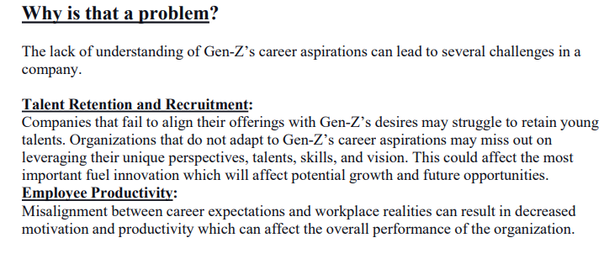
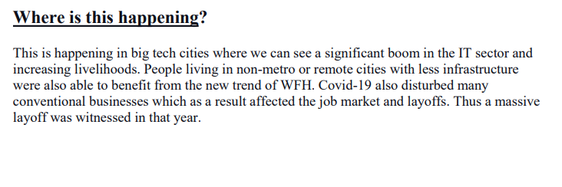
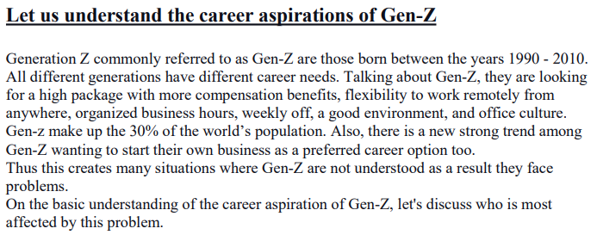
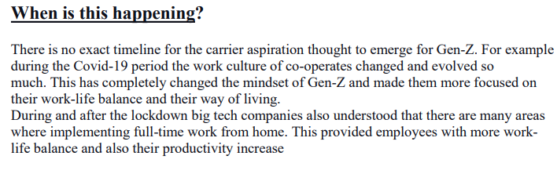
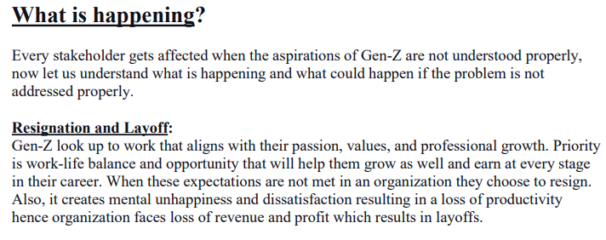
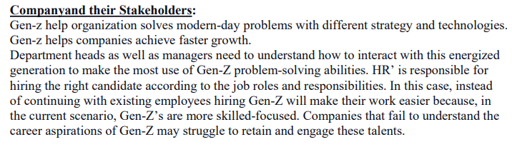
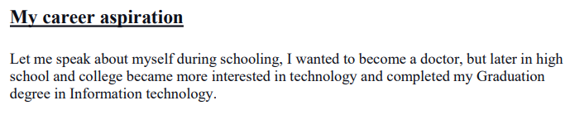
Business Research Document

Slide 5
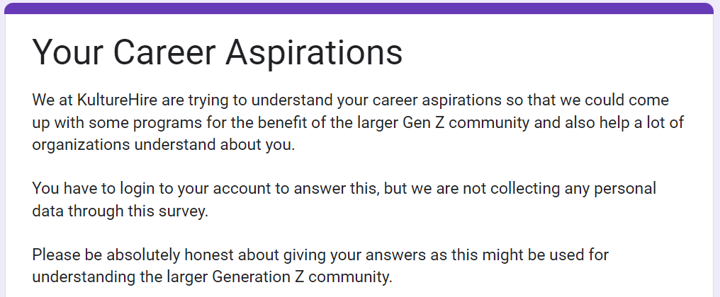
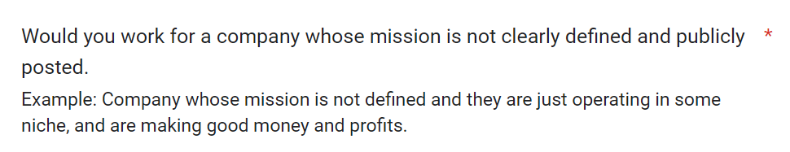
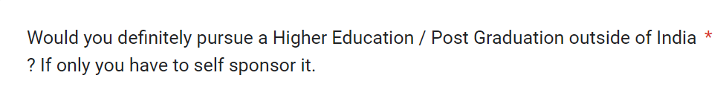
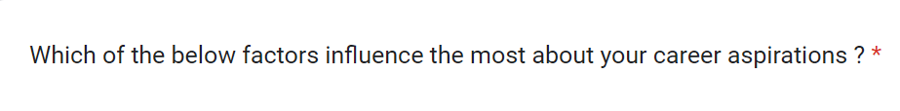
Data Collection
Data collection improves customer experience and drives better decision-making and overall growth for businesses across the board.
For our problem statement we gathered data from the Gen-Zs through platforms like LinkedIn, Instagram, etc.
We received around 3179 complete forms and around 60,000 responses. The responses were roughly from 1800 different Postal codes across India.

Slide 6
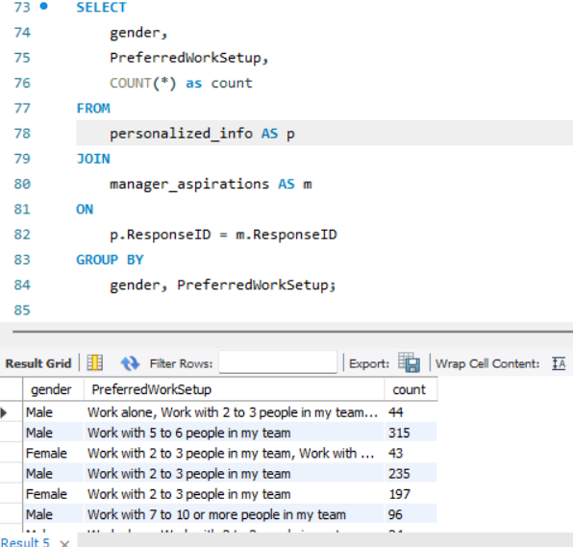
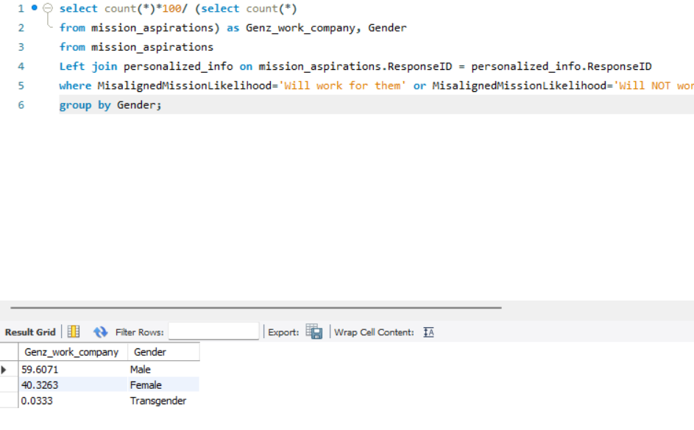
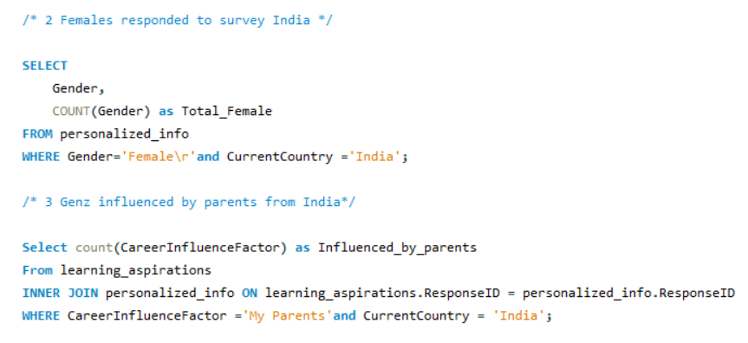
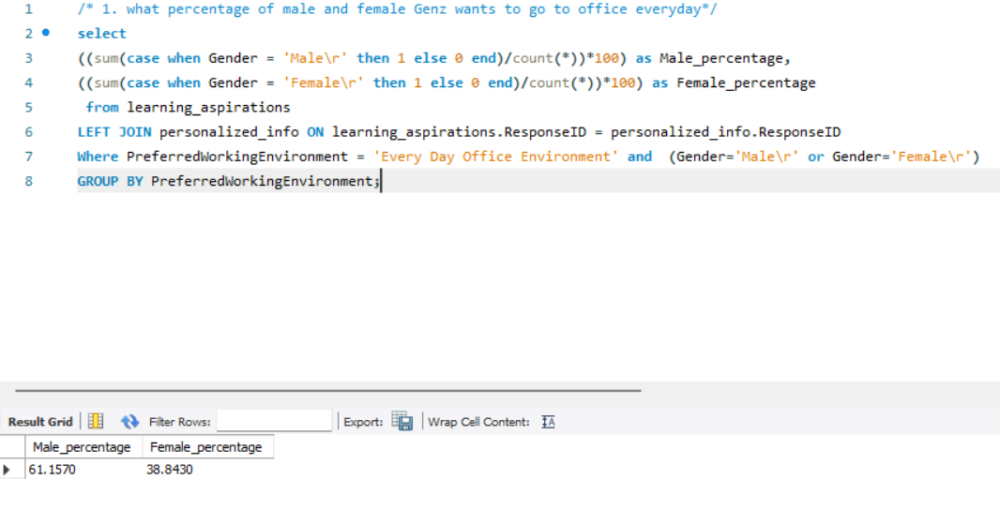
Cleaning the data and Analysis of Business questions using SQL
Worked on MYSQL Server Workbench. Imported data from csv and xlsx files to the server, wrote codes to get the answers to the required for the Analysis of Business questions.
Solved business questions and here we have some snippets of the codes along with the outputs:

Slide 7
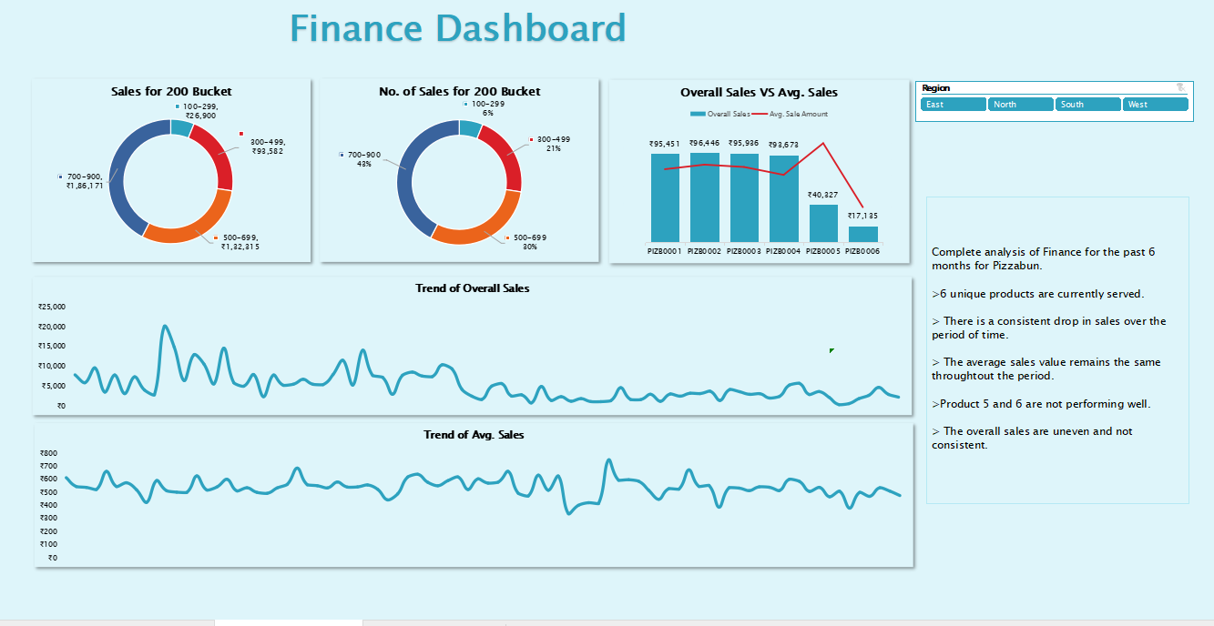
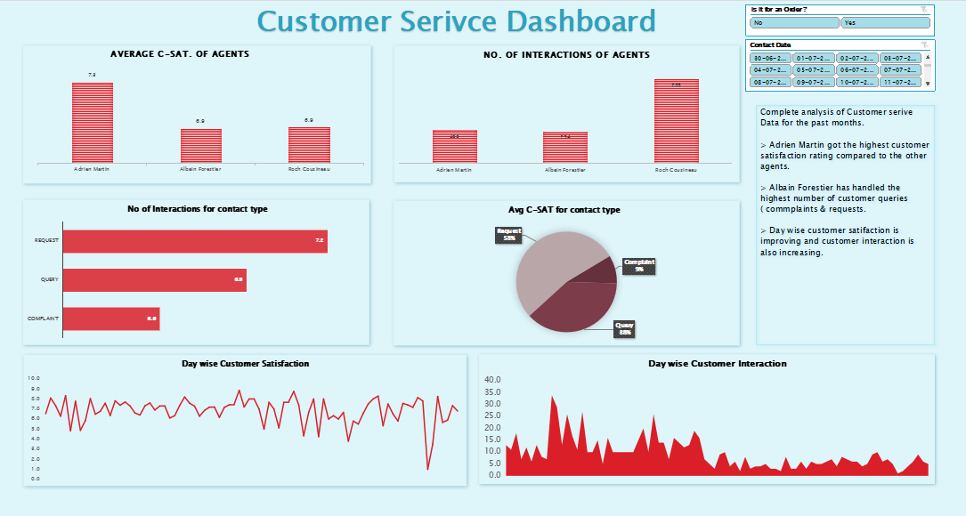
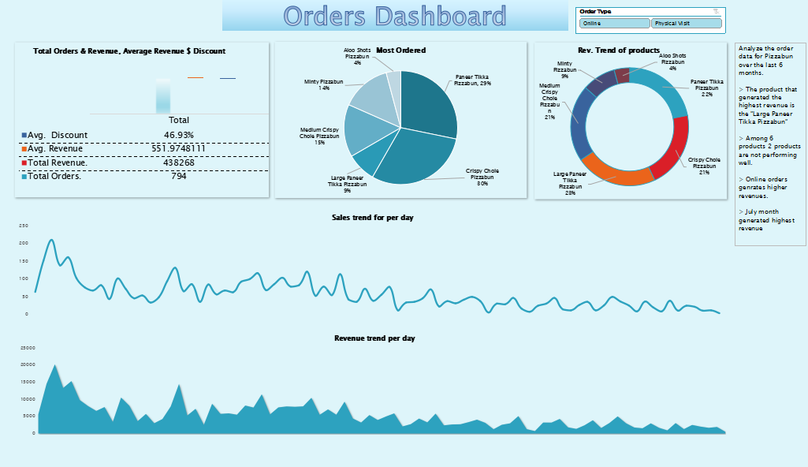
Comprehensive Dashboard
Comprehensive dashboards
Customer Service
Finance Dashboard
Orders Dashboard

Slide 8
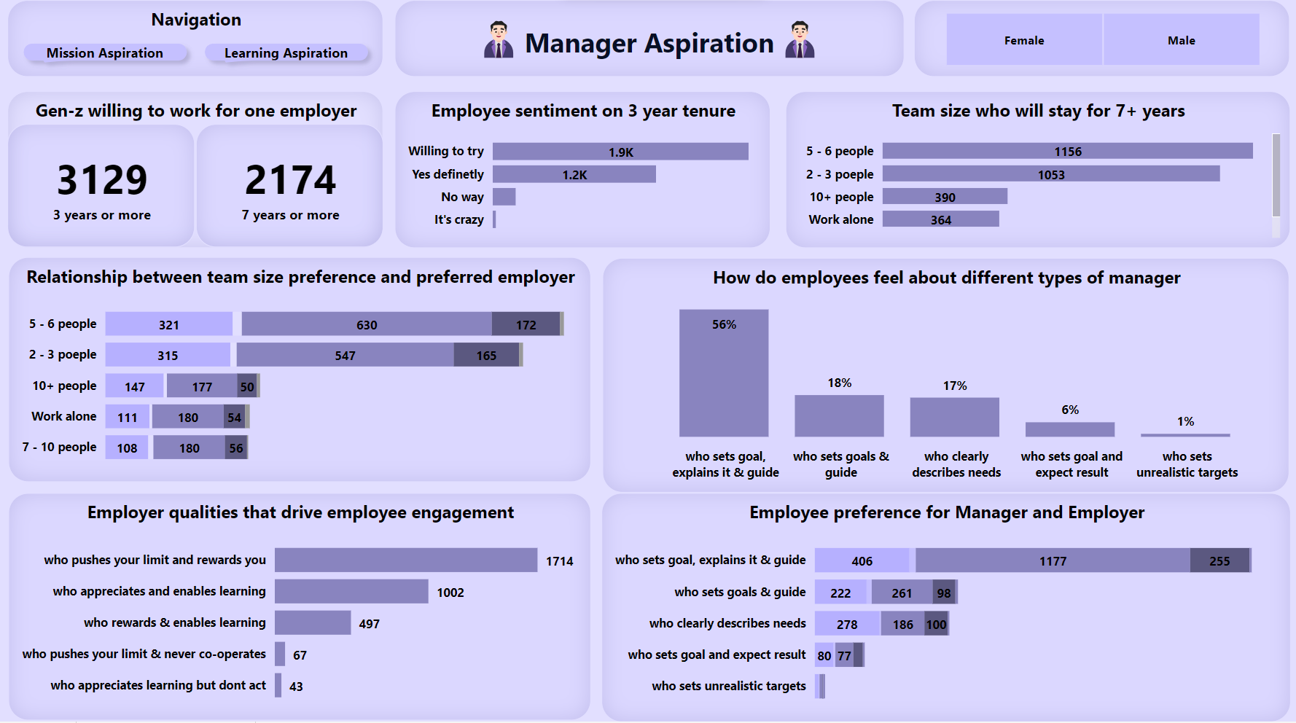
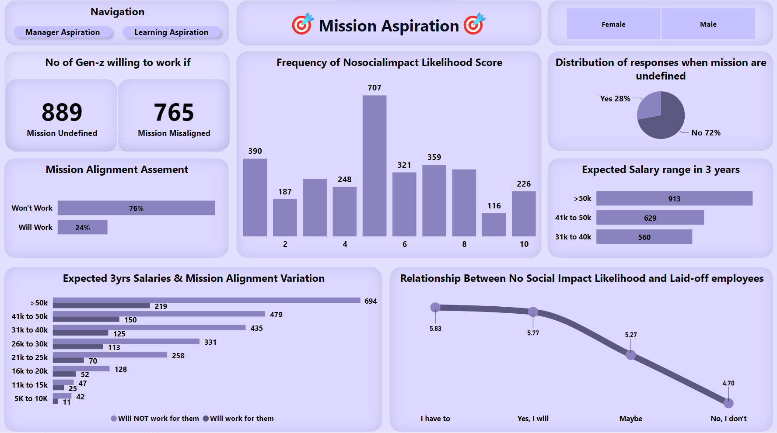
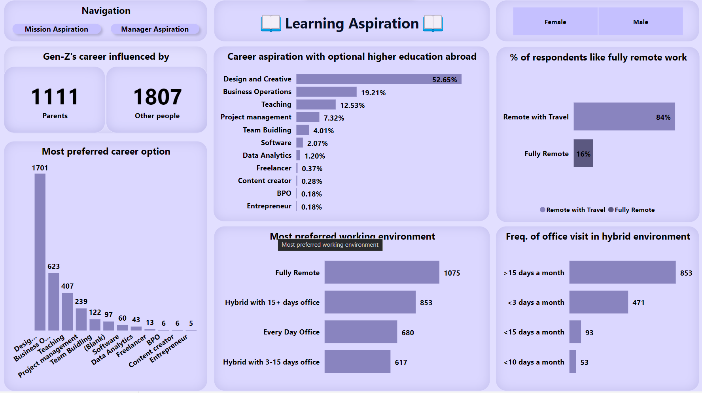
Functional Dashboard
Functional dashboards for Gen-Z Career Aspiration
Mission Aspirations
Manager Aspirations
Learning Aspirations

Slide 9

BYJU'S is India's largest ed-tech company
It was Launched in the year 2015.
BYJU'S offers highly personalized and effective learning programs for classes 1 - 12 (K-12), and aspirants of competitive exams.
It has a global reach and operates in over more 15 countries.
With 50 million registered students, BYJU'S has become one of the most preferred education platforms across the globe.

Slide 10
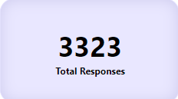
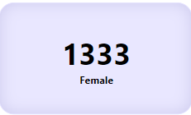
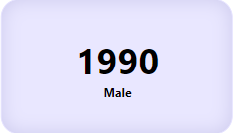
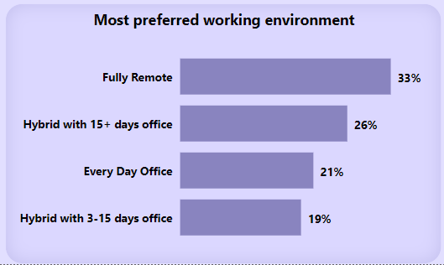
Final Insights
Problem Statement:
As per Glassdoor the overall rating for Byju's is 2.5 out of 5, based on 18287 reviews with late working hours, constant pressure to meet the targets and leading to drained energy, stress and a poor work-life balance.
Recommendations:
Out of the total data collected, approximately 52% of Gen-Z individuals express a willingness to work in a hybrid work environment.
Byjus should implement a more structed work schedule with clear boundaries between work and personal time.
Flexible working options.

Slide 11


Thank you!!

